Slide 1
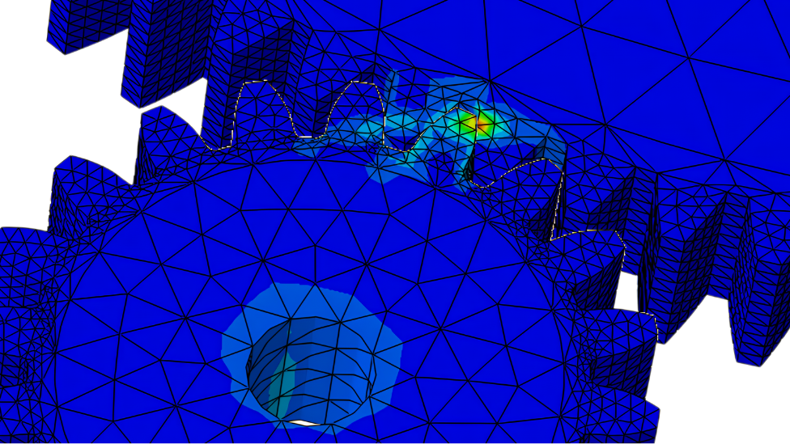
3D Contact Stress & Plasticity Analysis of Spur Gears
FEA Design Project
210494D
Premakumara H.P.S.
MT4810
Notes:
Good morning/afternoon. Today I present a 3D finite element analysis of a spur gear assembly, simulating contact stresses and plastic deformation under high torque conditions.

Slide 2
Objectives & Engineering Strategy
Primary Goal:
⚙️ 3D Contact Stress Analysis
🧪 Plastic Deformation (PEEQ) Prediction
📉 Mesh Convergence Study
Strategic Implementation:
Modeling: Parametric CAD via Solid Edge 2025 (Exact Involute).
Simulation: Full 3D Analysis (Beyond 2D Plane Strain).
Optimization: Mesh Partitioning for max efficiency.
Notes:
While the standard requirement is a 2D analysis, this project employs a full 3D simulation. This allows us to observe stress concentrations along the face width and realistic contact pressures that 2D plane strain assumptions might miss.

Slide 3
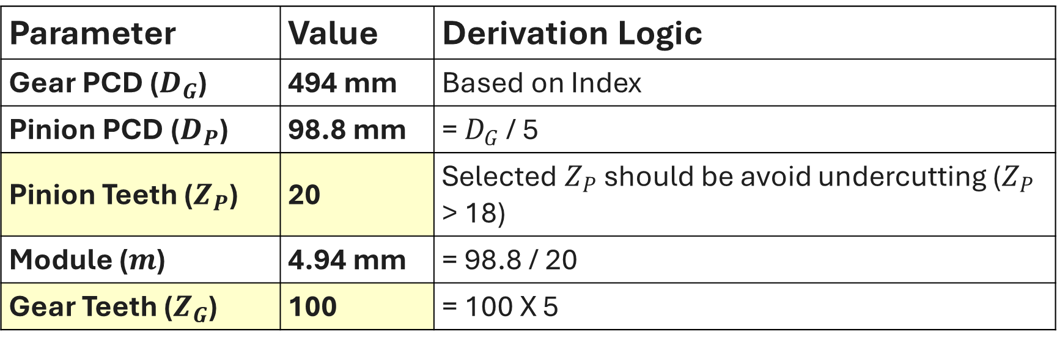
Geometric Design Parameters
Parameter | Value | Derivation Logic
Gear PCD ($D_{G}$) | 494 mm | Based on Index
Pinion PCD ($D_{P}$) | 98.8 mm | = $D_{G}$ / 5
Pinion Teeth ($Z_{P}$) | 20 | Selected $Z_{P}$ should be avoid undercutting ($Z_{P}$ > 18)
Module ($m$) | 4.94 mm | = 98.8 / 20
Gear Teeth ($Z_{G}$) | 100 | = 100 X 5
Notes:
Based on my index ending in 494, the Gear diameter is set to 494mm. To prevent undercutting in the pinion, I selected a minimum of 20 teeth, which resulted in a module of 4.94 mm.

Slide 4
Critical Engineering Assumptions
Loading Given: Torque Magnitude = 494 Assumed Unit: Nm (Newton Meters) Reason: 494 Nmm is negligible for a Ø494mm steel gear. To trigger the plastic region as requested, a realistic torque of 494 Nm is applied. | Modeling Geometry: Involute Profile generated via Solid Edge 2025. Reason: Sketching in FEA tools is approximate. Dedicated CAD ensures geometric accuracy of the contact interface.
Notes:
A key decision was made regarding the load units. Since the project requires analyzing plasticity, a torque of 494 Nmm would be insufficient to yield steel. Therefore, 494 Nm was chosen to simulate a realistic failure scenario.

Slide 5
Simulation Workflow
CAD Modeling
  Precise Involute Generation
  Use Solid Edge
Pre -Processing
  Material (Plasticity), Contact & Mesh
  Use Abaqus
Solving
  Static General Step (Non – linear)
  Use Abaqus
Results & Validation
  Stress concentration, Failure & Mesh convergence Study
  Use Abaqus
Notes:
My simulation workflow emphasizes geometric accuracy. Instead of sketching approximations within the FEA tool, I utilized Solid Edge 2025 to generate the precise mathematical involute profiles of the gears. These were then exported to Abaqus for the physics setup, followed by a rigorous mesh convergence study to validate the results.

Slide 6

Material Definition: Stainless Steel
Elastic Properties:
Young's Modulus ($E$): 193 GPa (approx.)
Poisson's Ratio ($ν$): 0.3
Plastic Properties:
Yield Strength: ~250 MPa
Notes:
For the material, Stainless Steel was selected. Since the objective is to capture permanent deformation, defining only the Elastic properties like Young's Modulus is not enough. Therefore, I incorporated the Plasticity data—specifically the yield stress and plastic strain values—to allow the solver to predict behavior after the material exceeds its yield point.

Slide 7
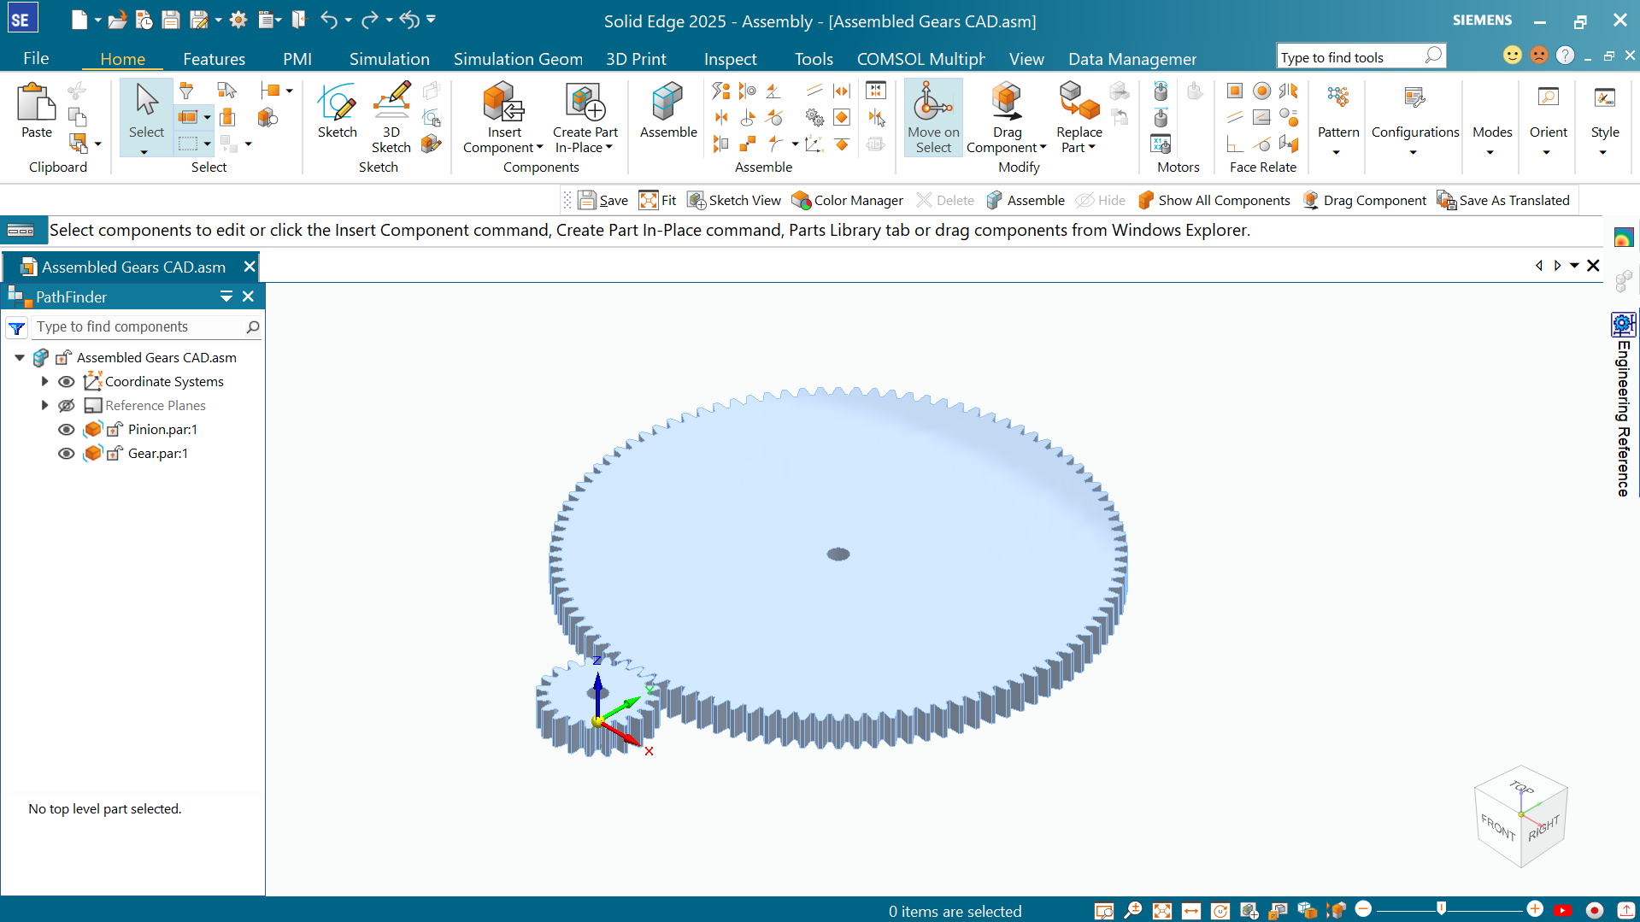
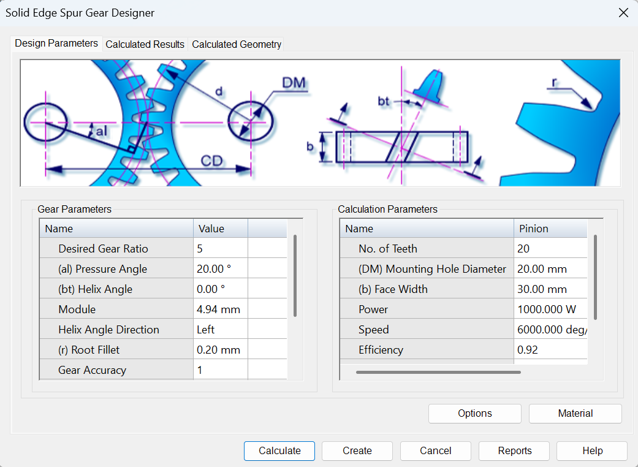
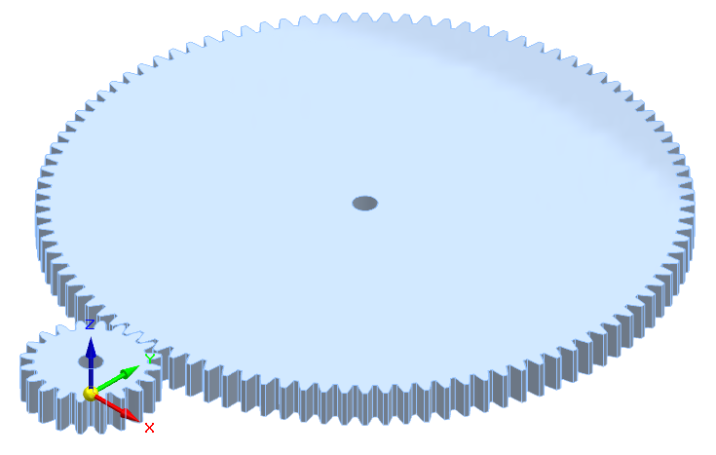

Parametric CAD Generation
Input Parameters based on index calculations
Generated Assembly with precise Involute Profile
Notes:
To ensure the highest accuracy of the contact simulation, I avoided manual sketching. Instead, I used the parametric Spur Gear Designer in Solid Edge 2025, inputting the calculated module of 4.94mm to generate the exact involute geometry.

Slide 8
Parametric CAD Generation
Input Parameters based on index calculations
Generated Assembly with precise Involute Profile
Notes:
To ensure the highest accuracy of the contact simulation, I avoided manual sketching. Instead, I used the parametric Spur Gear Designer in Solid Edge 2025, inputting the calculated module of 4.94mm to generate the exact involute geometry.

Slide 9
Parametric CAD Generation
Input Parameters based on index calculations
Generated Assembly with precise Involute Profile
Notes:
To ensure the highest accuracy of the contact simulation, I avoided manual sketching. Instead, I used the parametric Spur Gear Designer in Solid Edge 2025, inputting the calculated module of 4.94mm to generate the exact involute geometry.

Slide 10
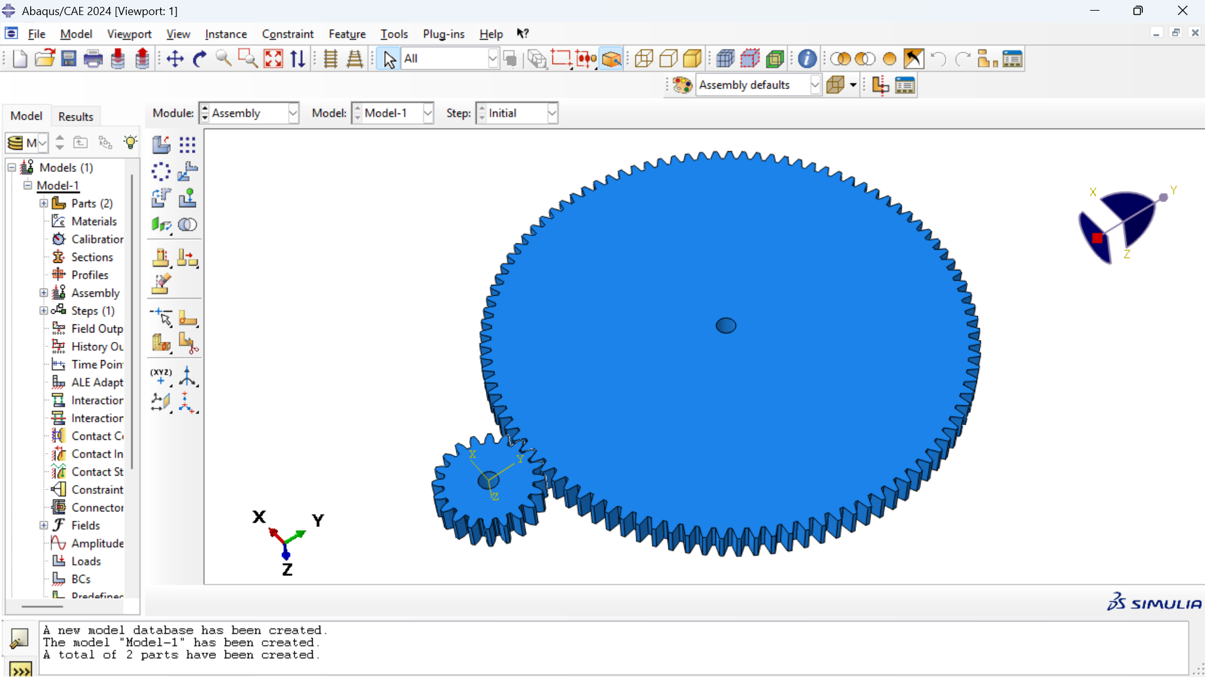
CAD to CAE Integration
Import Format: STEP (.stp)
Method: Direct Assembly Import (Maintained Solid Edge coordinates).
Advantage: Eliminates manual positioning errors in FEA environment.
Imported Assembly Abaqus
Notes:
Moving to pre-processing, the assembly was imported as a STEP file. Unlike manual assembly within Abaqus, which is prone to positioning errors, this method preserved the exact center distance and contact interface defined in Solid Edge.

Slide 11
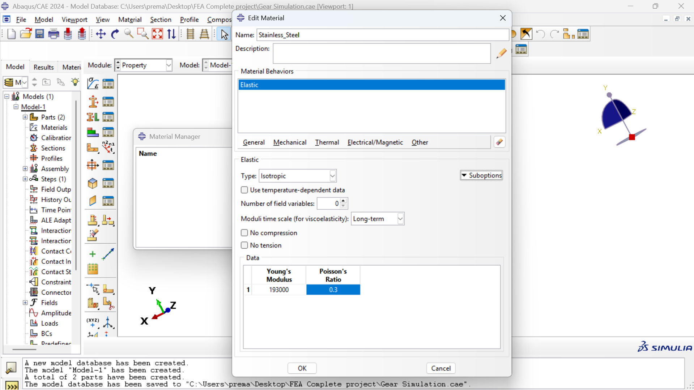
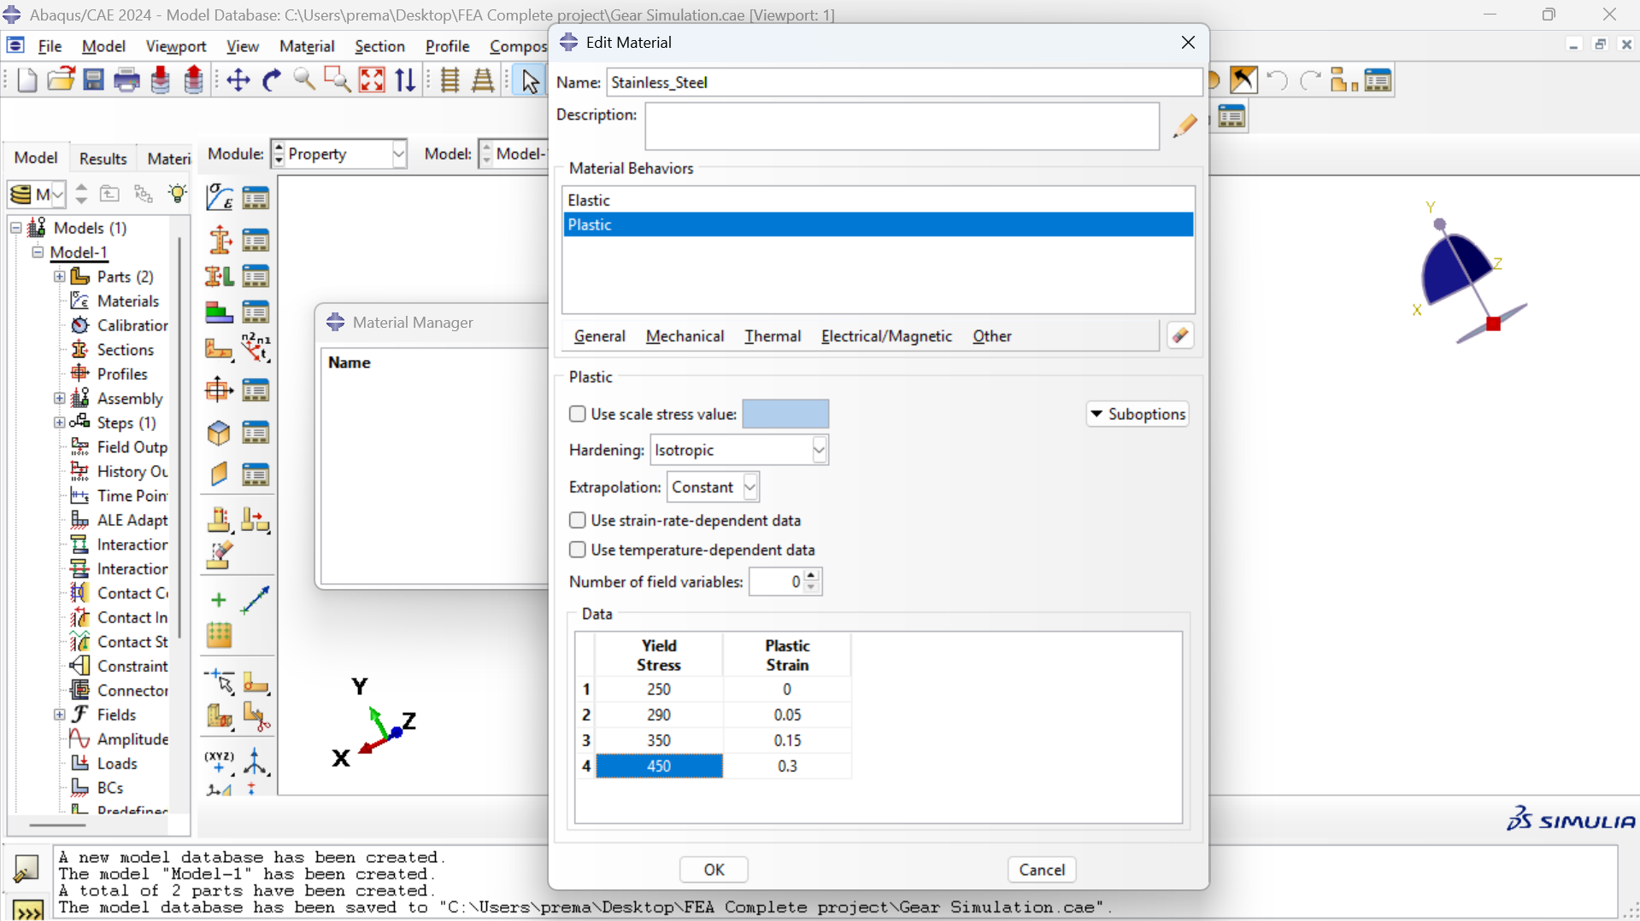
Material Definition
Non-linear Material definition with Plasticity data for Stainless Steel
Material: Stainless Steel
Behavior: Elastoplastic
Yield Criterion: Von Mises (Isotropic Hardening).
Notes:
To capture realistic failure modes, I defined Stainless Steel with both elastic and plastic properties. The plasticity data allows the simulation to predict permanent deformation at the gear teeth under high stress, rather than assuming infinite elasticity.

Slide 12
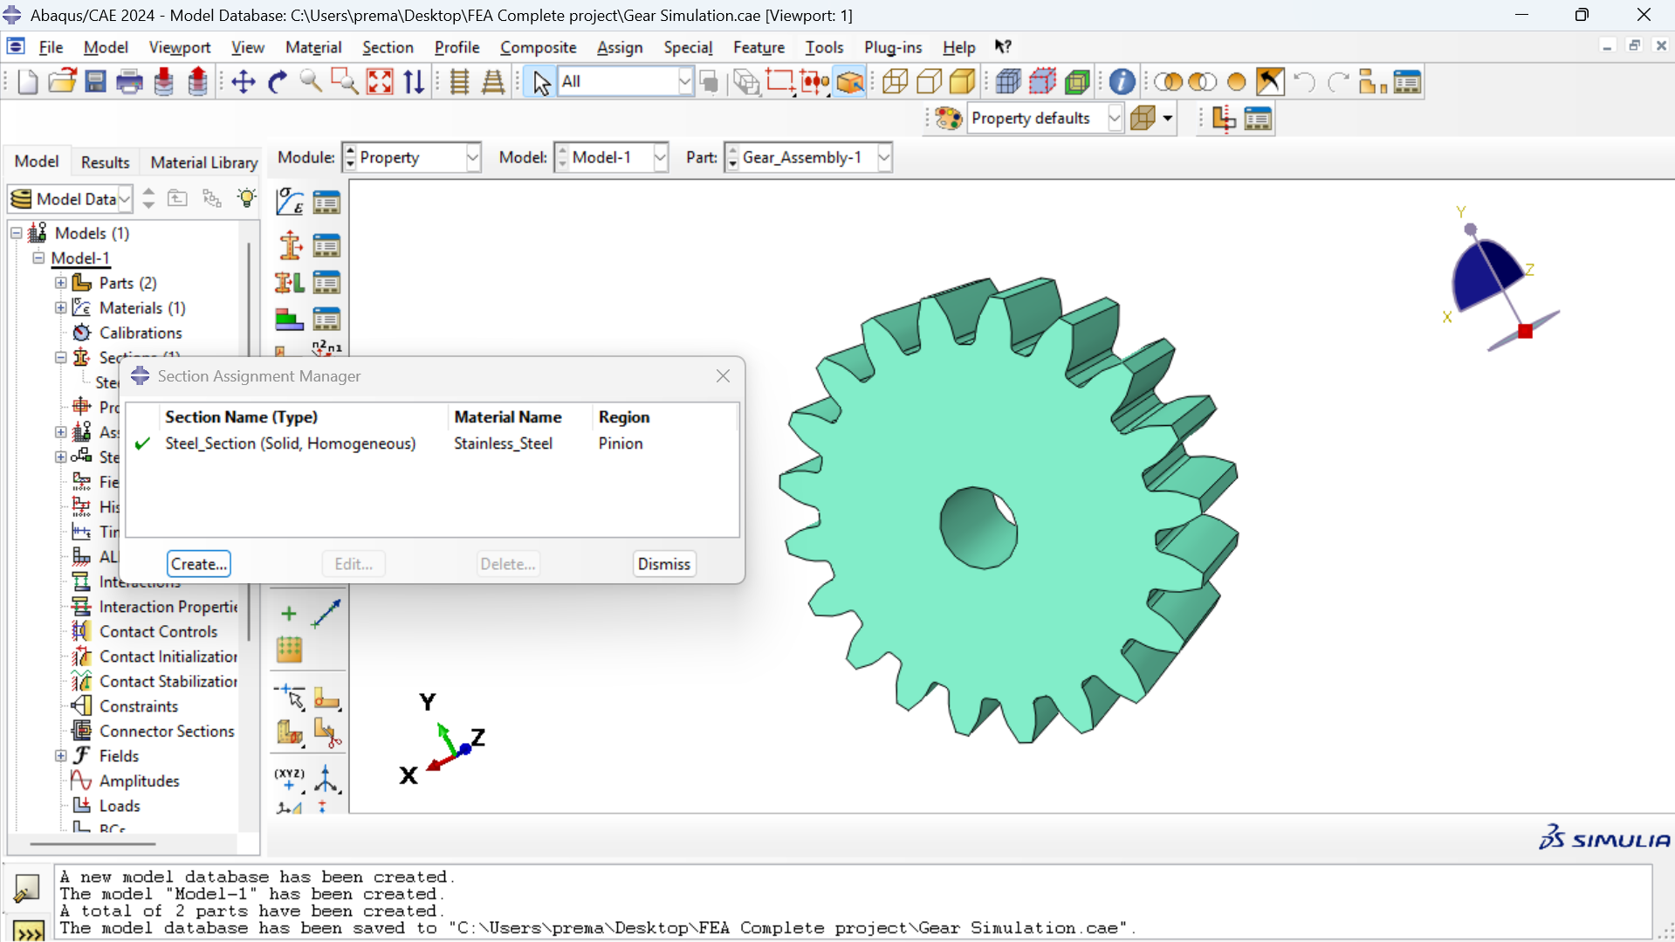
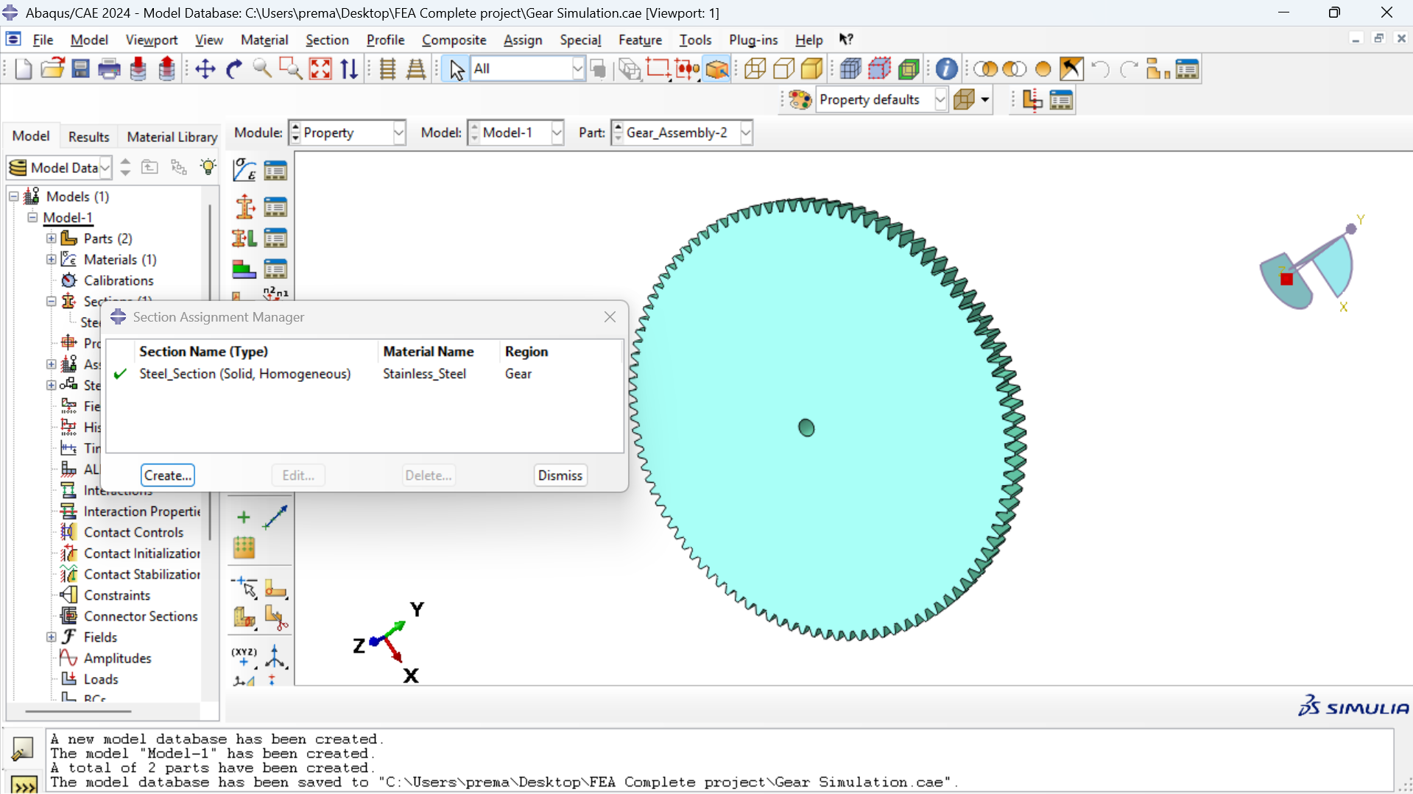
Material Assignment: Homogeneous Solid Sections
Material Assignment successful

Slide 13
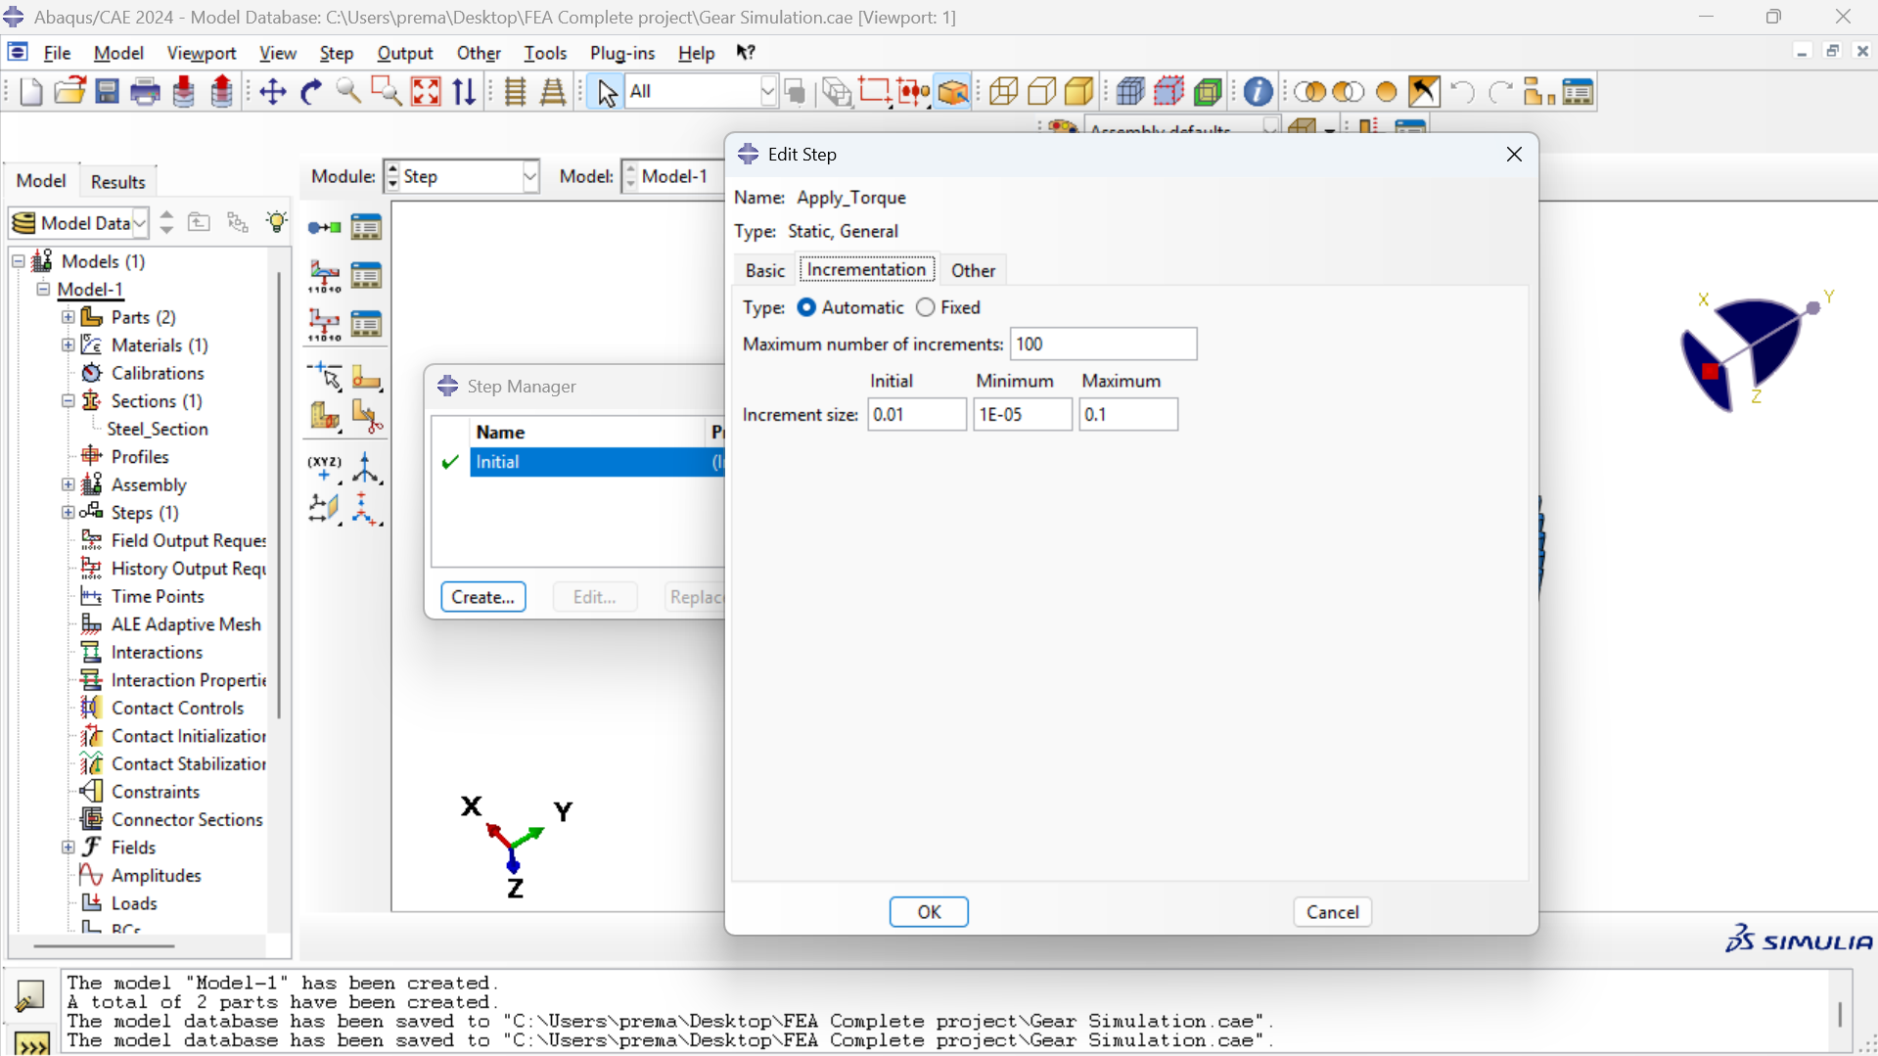
Step Definition: Non-linear Static General Analysis
Enabling Non-linear Geometry (Nlgeom) to account for large displacements and contact

Slide 14
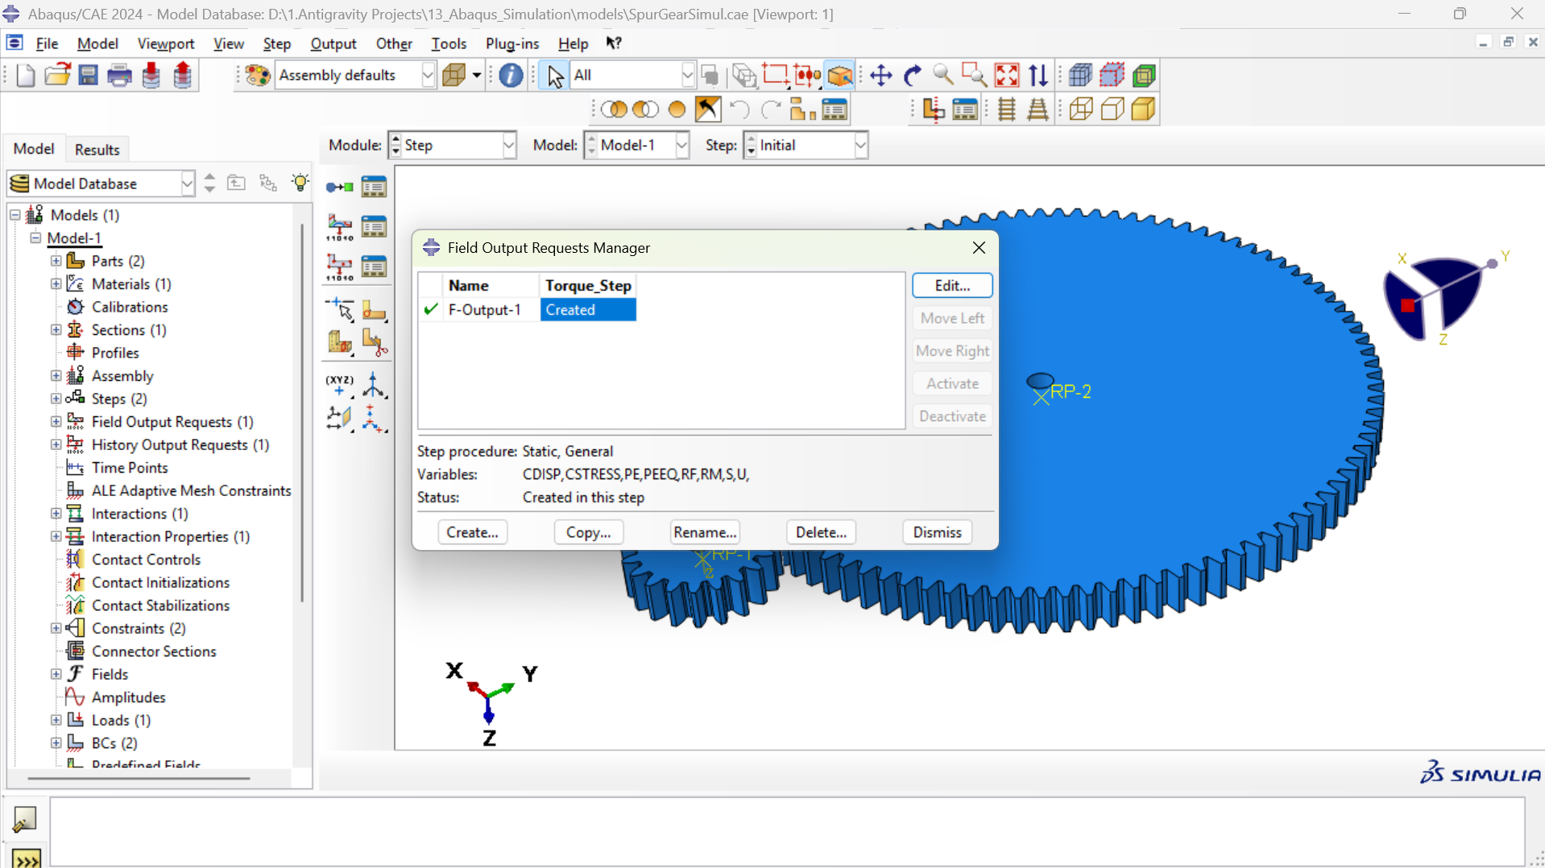
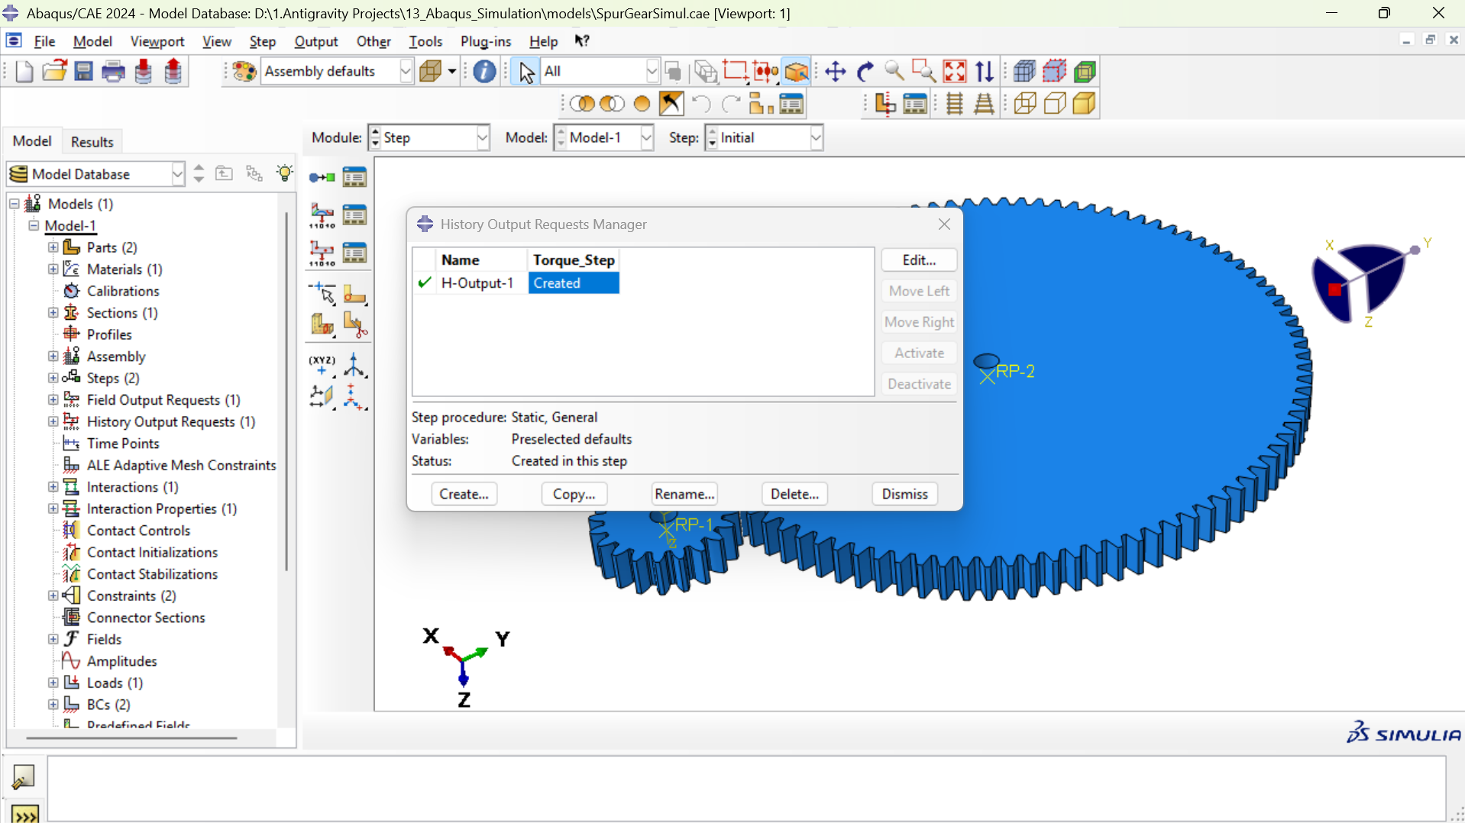
Step Configuration: Field & History Output Requests
Field Output Requests (F-Output-1)
Domain: Whole Model (Preselected Defaults + Contact Variables)
Output Variables: Stress components (S, Mises, Max Principal), Strain (E, PEEQ), Displacement (U)
Contact Variables: CSTRESS (Contact Pressure) and CDISP (Slip)
Frequency: Output saved at every converged increment across step time (0 to 1.0)
History Output Requests (H-Output-1)
Domain: Whole Model and Bore Reference Points
Energy Balance: Internal energy (ALLIE), kinetic energy (ALLKE), plastic dissipation (ALLPD)
Kinetic Energy Verification: ALLKE < 1% ALLIE confirming quasi-static equilibrium
Reaction Quantities: Reaction force (RF) and torque moment (RM) at fixed pinion reference point

Slide 15
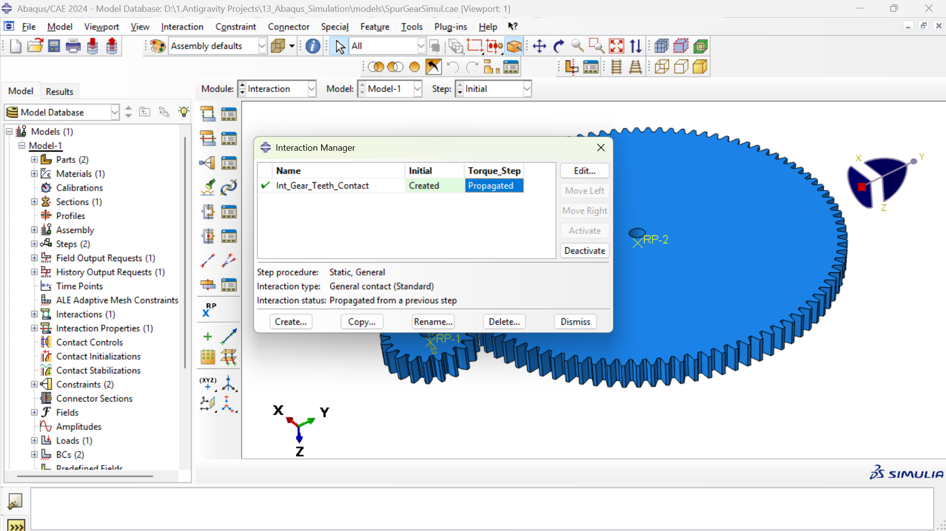
Contact Interaction: General Contact Formulation
General Contact (Standard) Architecture
Formulation Type: General contact (Standard) active across Torque_Step
Contact Domain: 'All* with exterior' automatically selected
Robust Surface Tracking: Eliminates manual master-slave pair definition, preventing surface inversion errors
Dynamic Feature Tracking: Automatically captures newly engaged tooth pairs as gears rotate under torque load
Self-Contact Capability: Handles multi-tooth engagement and contact boundary evolution automatically
Penalty Constraint Enforcement: Enables smooth numerical convergence with finite contact stiffness

Slide 16
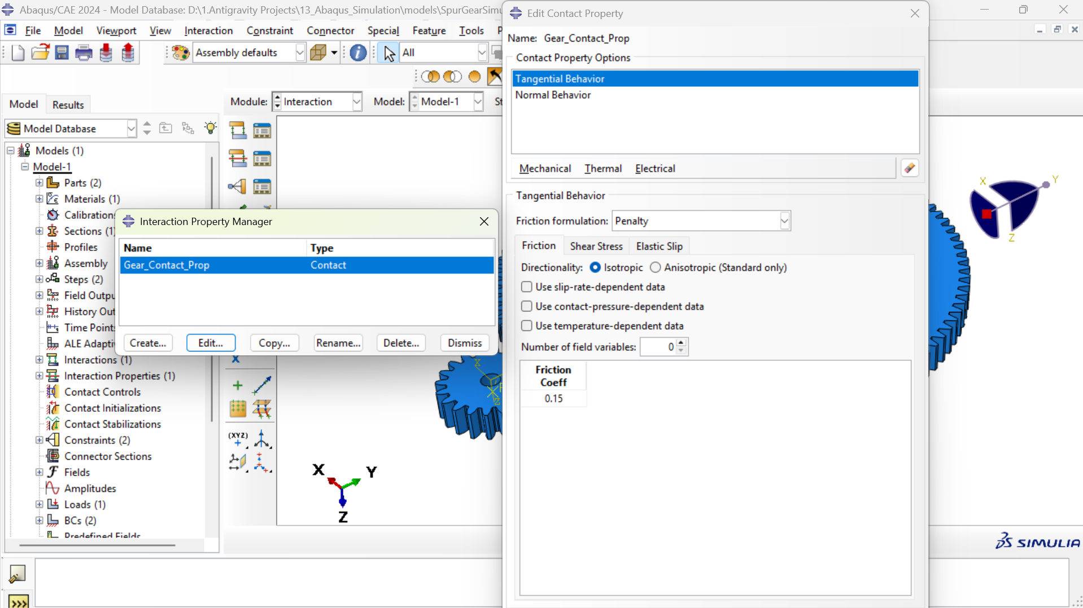
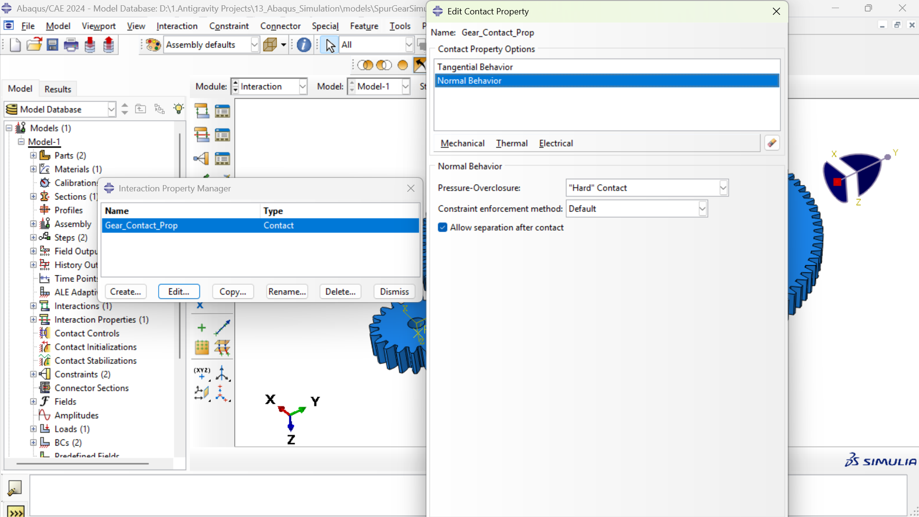
Contact Properties: Tangential & Normal Behavior
Tangential Behavior: Penalty Friction
Friction Formulation: Penalty Method (robust for non-linear solver)
Friction Coefficient (μ): 0.15 (Standard lubricated industrial steel gear mesh)
Directionality: Isotropic slip behavior along tooth flanks
Elastic Slip Tolerance: Abaqus default relative permissible displacement before sliding
Normal Behavior: Hard Contact Pressure
Pressure-Overclosure: 'Hard' Contact model
Constraint Enforcement: Default penalty-based multiplier
Penetration Resistance: Transmits unlimited compressive stress when contact is closed
Allow Separation: True (teeth cleanly separate when out of mesh without artificial tensile adhesion)

Slide 17
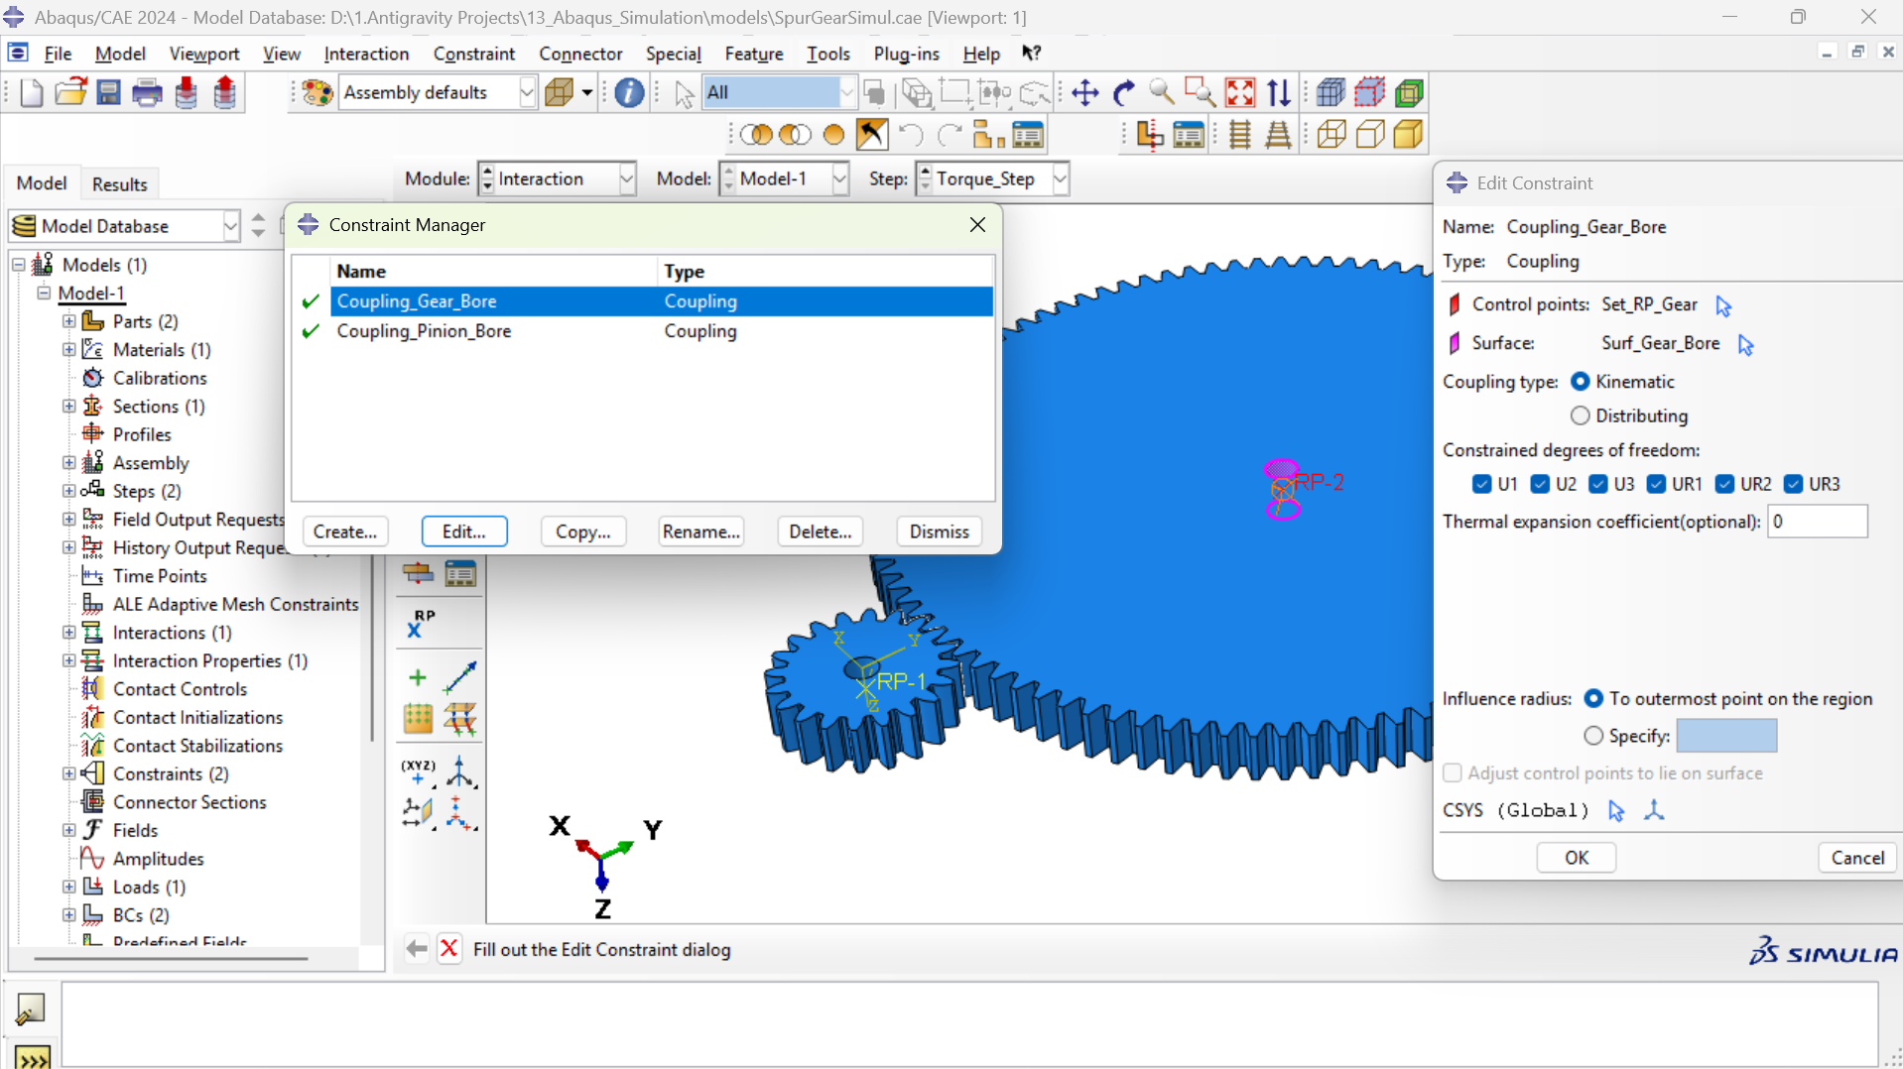
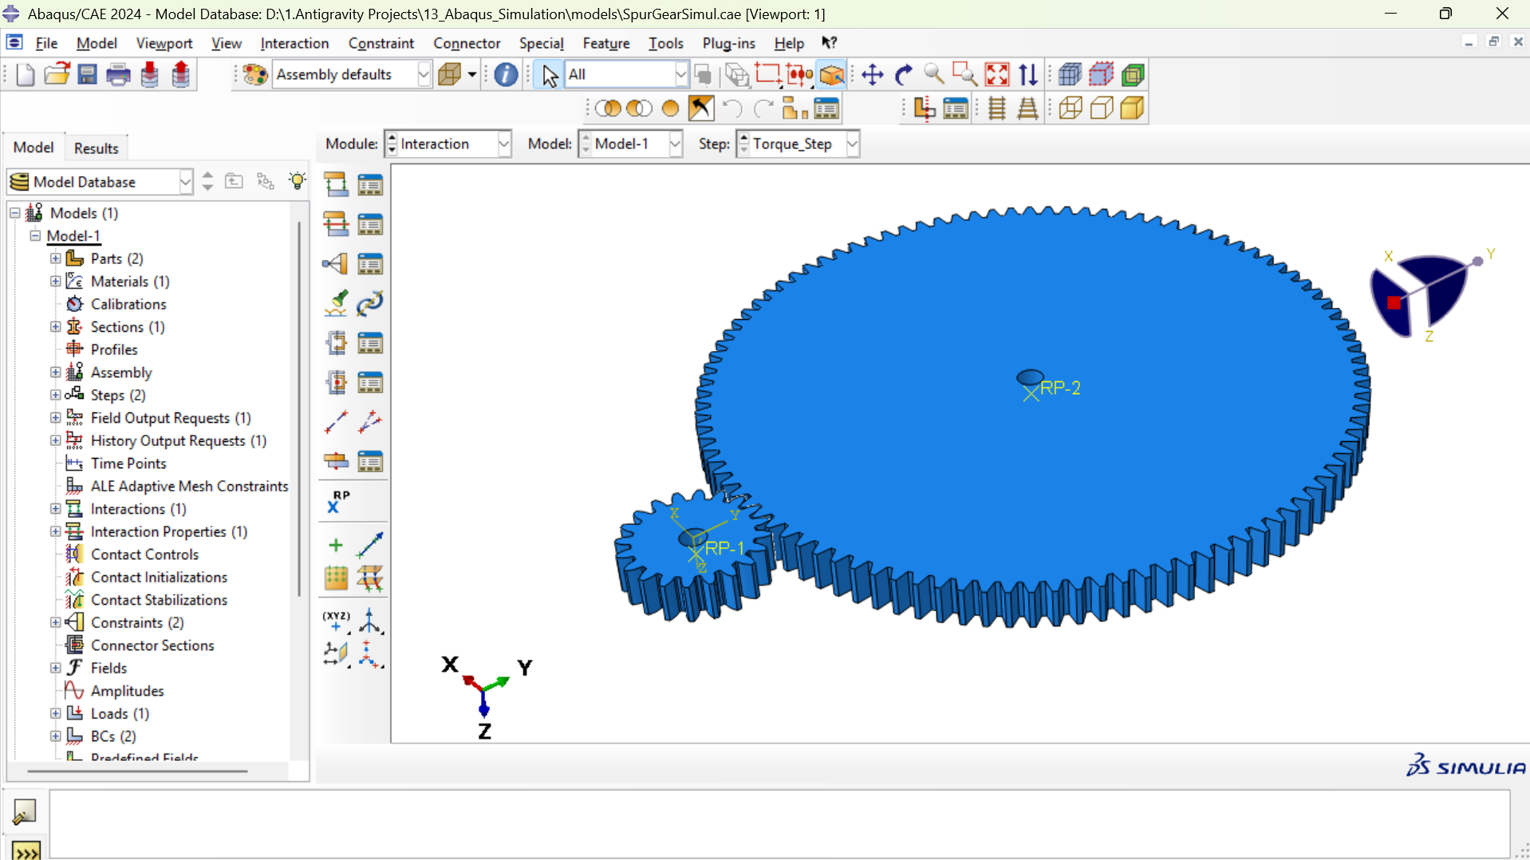
Boundary Constraints: Kinematic Shaft Couplings
Kinematic Coupling Definition
Control Points: Rigid Reference Points at gear center (RP-1) and pinion center (RP-2)
Coupled Surfaces: Inner cylindrical bore faces (Bore Diameter = 20.0 mm)
Degrees of Freedom Constrained: All 6 DOFs (U1, U2, U3, UR1, UR2, UR3)
Eliminates Artificial Stress Singularities: Distributes driving torque evenly across bore circumference
Shaft Kinematics & Equilibrium
Rigid Shaft Emulation: Replaces physical shaft while accurately capturing torsional stiffness
Center Distance Maintenance: Rigid reference points fix pitch center distance at exactly 296.4 mm
Bore Surface Regularization: Prevents localized mesh distortion around the inner hole during rotation
Clean Reaction Extraction: Direct extraction of total reaction moments RM3 and forces RF

Slide 18
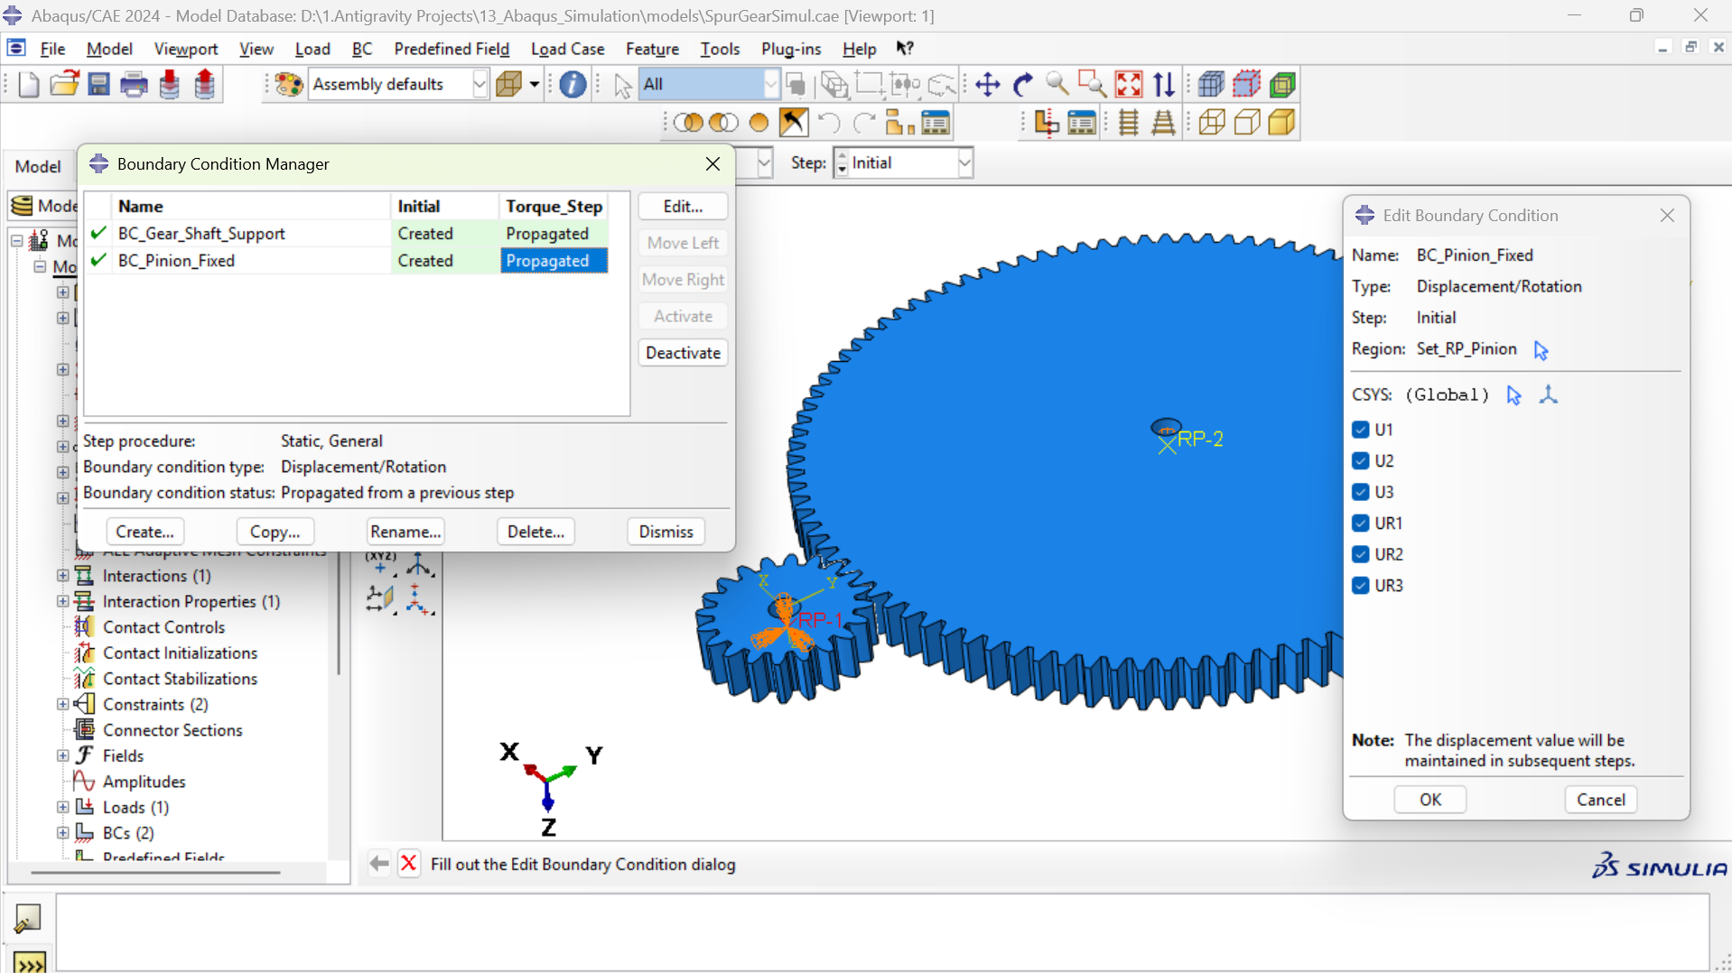
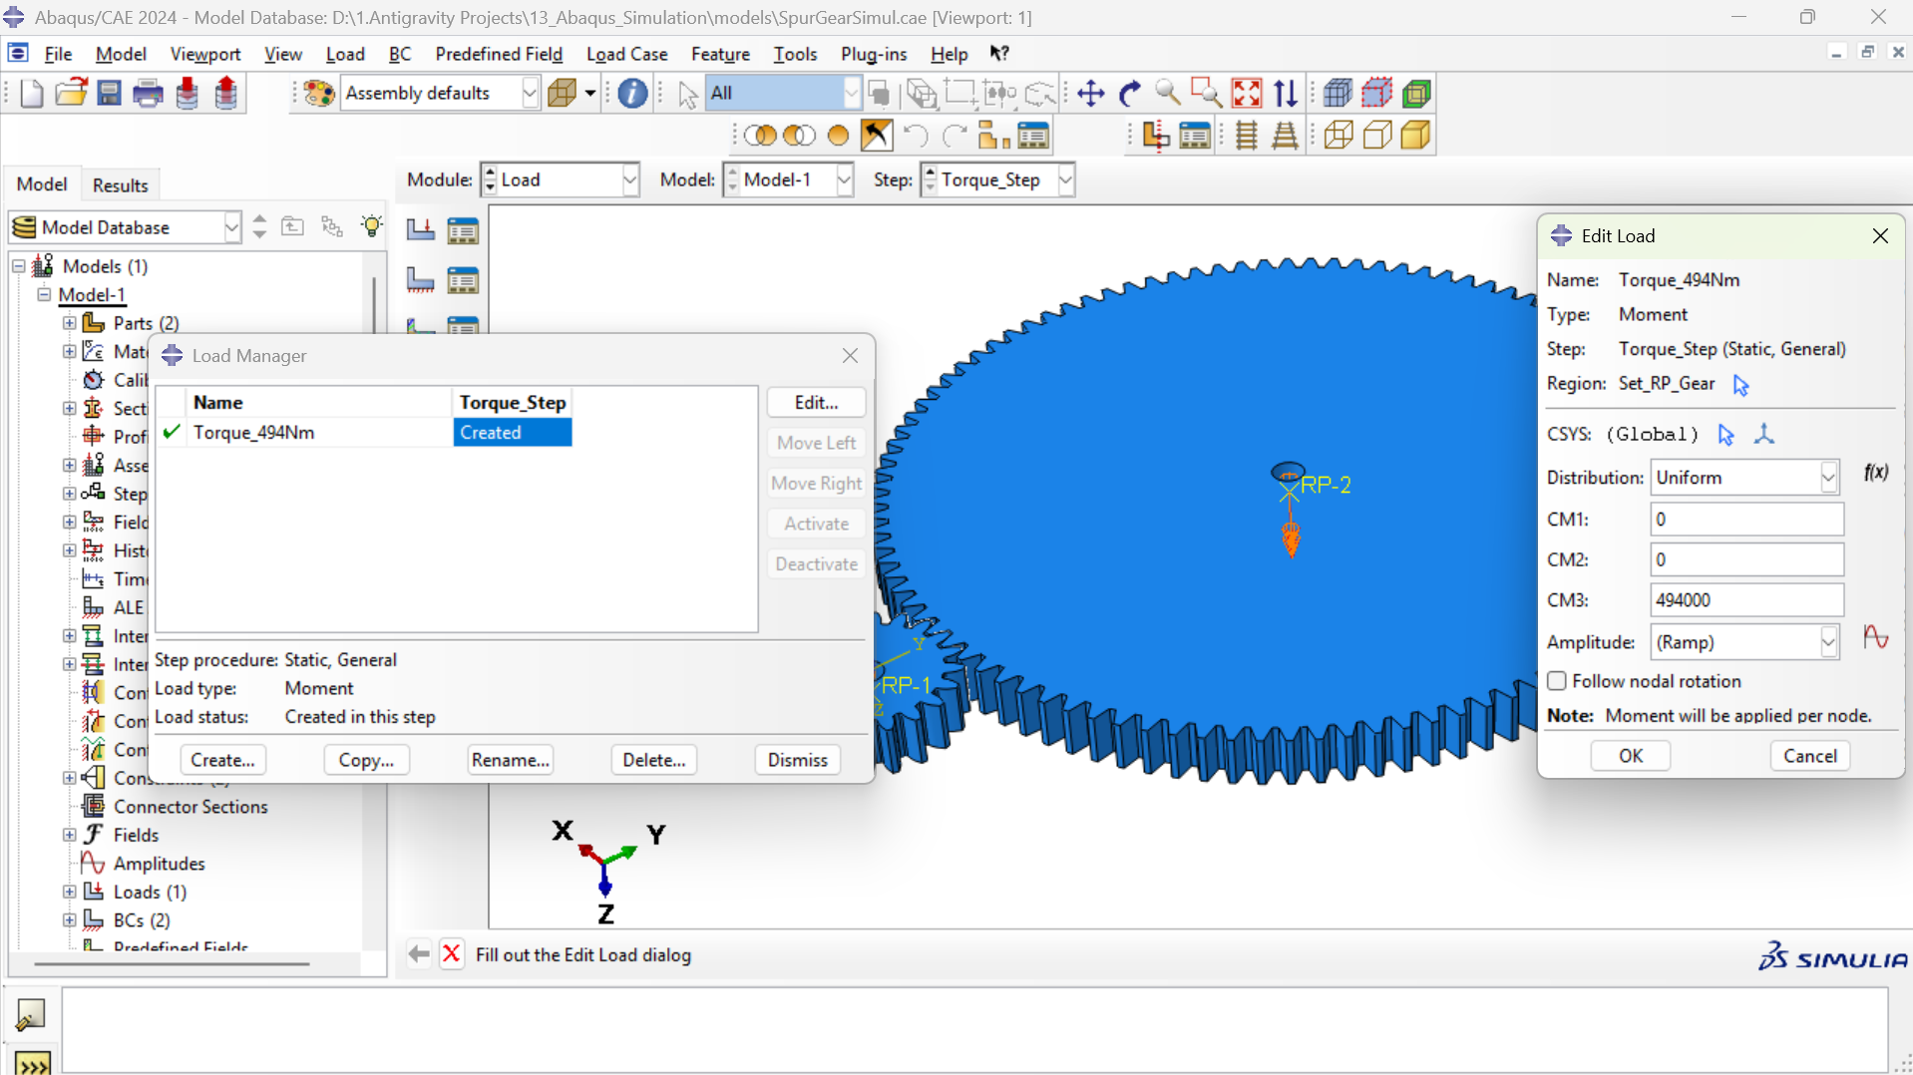
Loading & Boundary Conditions: Torque Application
Pinion Constraint: Fixed Encastre
Target Node: Set_RP_Pinion (coupled to Pinion Bore surface)
Boundary Type: Fully Fixed Encastre (U1=U2=U3=UR1=UR2=UR3=0)
Engineering Role: Simulates locked output shaft / resisting driven load
Reaction Monitoring: Captures the resisting torque and radial separating forces
Gear Support & Applied Driving Torque
Target Node: Set_RP_Gear (coupled to Gear Bore surface)
Support BC: Pin Support (U1=U2=U3=UR1=UR2=0, UR3 free to rotate about Z-axis)
Applied Torque Load: Moment CM3 = 494,000 N·mm (494.0 N·m based on Index 210494)
Load Application: Applied smoothly via Ramp amplitude across step time (0 to 1.0)

Slide 19
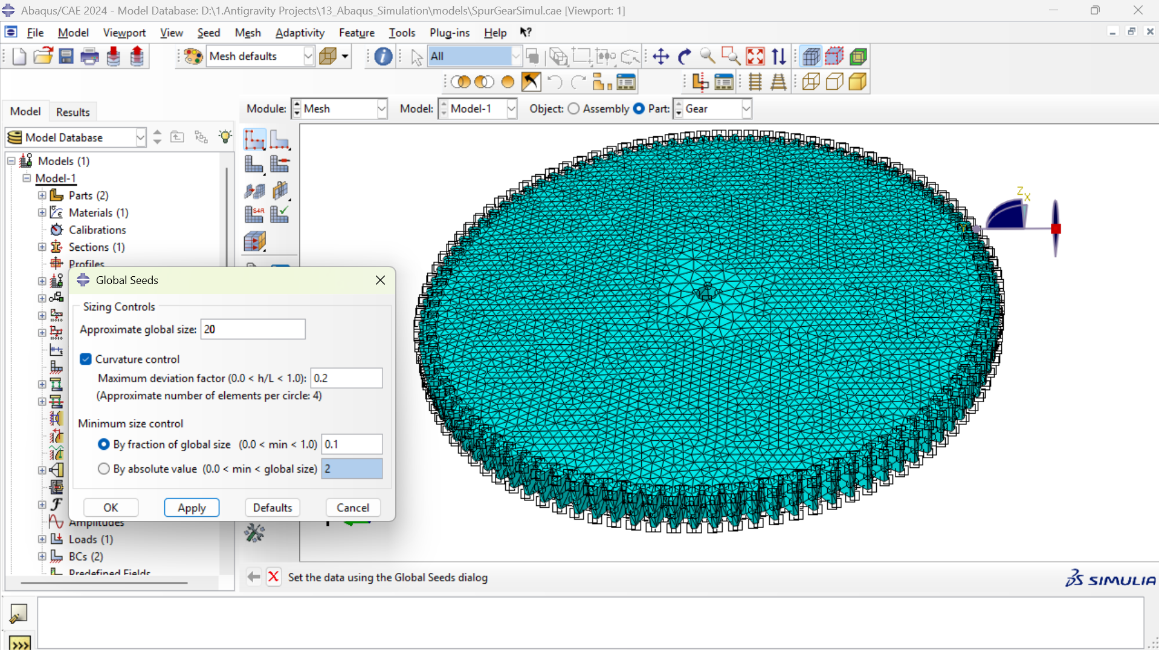
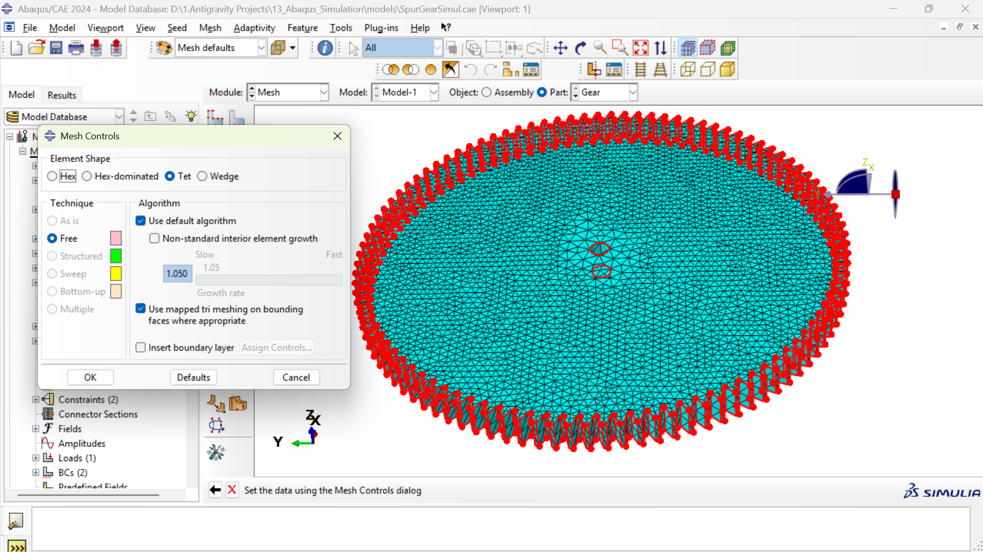
Finite Element Meshing: Strategy & Sizing Controls
Global Seeding & Curvature Control
Element Sizing: Parametric global seeding scaled across convergence study (20mm to 9mm)
Curvature Control: Maximum deviation factor h/L = 0.2 (Min 4 elements per circle arc)
Minimum Size Fraction: 0.1 of global size (minimum 2.0 mm limit)
Geometric Conformance: Ensures smooth representation of curved involute profile and root fillets
Element Type: C3D10 Quadratic Tetrahedral
Element Formulation: 10-node second-order tetrahedral solid elements (C3D10)
Parabolic Shape Functions: Eliminates volumetric locking and shear locking inherent in first-order tets
Meshing Technique: Free tetrahedral meshing with standard interior element growth
Boundary Layer: Mapped triangular meshing on boundary faces for superior contact surface smoothness

Slide 20
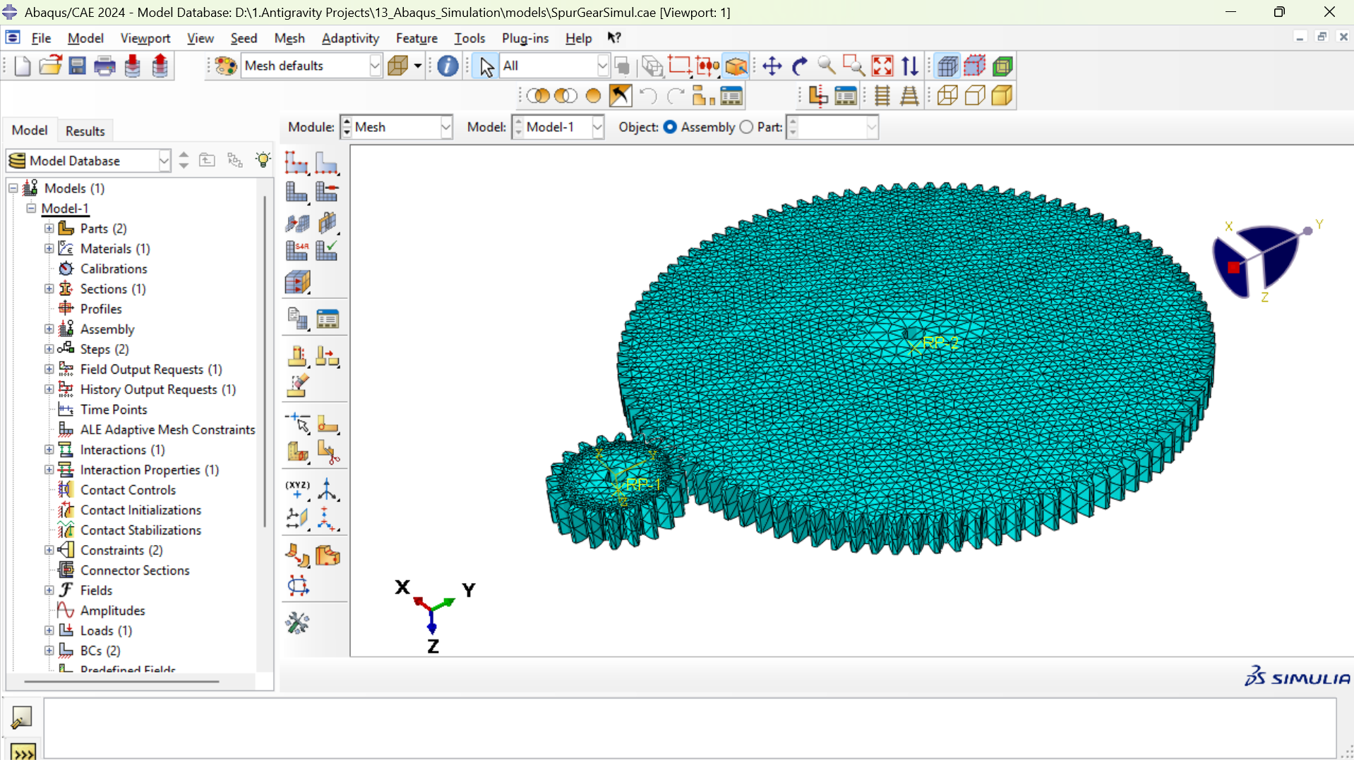
3D Discretized Gear Pair Assembly
Mesh Topology & Quality Metrics
Full 3D Solid Mesh: Both gear wheel and pinion fully discretized with continuum solid elements
Conformal Contact Zone: Curvature-based seeding automatically increases mesh density along involute tooth faces
Root Fillet Refinement: Captures high tensile bending stress gradients at the tooth root trochoid
Mesh Sizing Grid: Evaluated across 4 systematic levels (20mm, 16mm, 12mm, 9mm)
Peak Element Count: 113,902 elements and 174,807 nodes in the selected 9mm primary model
Element Quality Check: 0 distorted elements, 0 negative Jacobians, 100% solver pass rate

Slide 21
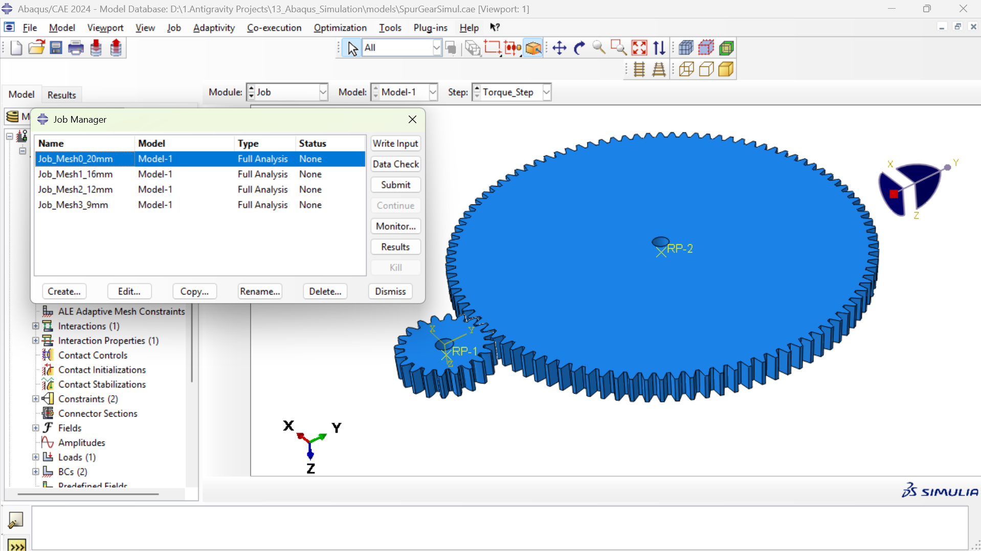
Mesh Convergence Study: Solver Execution
Abaqus/Standard Solver Execution
Solver Scheme: Abaqus/Standard implicit non-linear solver with Full Newton-Raphson iteration
Non-linear Formulations: Active contact non-linearity, large geometric deformation (Nlgeom), and plasticity
Parametric Jobs Executed:
• Job_Mesh0_20mm (81,952 elems)
• Job_Mesh1_16mm (91,707 elems)
• Job_Mesh2_12mm (102,134 elems)
• Job_Mesh3_9mm (113,902 elems)
Convergence Completion: All 4 models achieved 100% completion (Step Time = 1.000) without cutbacks or divergence
Output Database (ODB): Full stress, strain, displacement, and contact tensor fields archived for post-processing

Slide 22
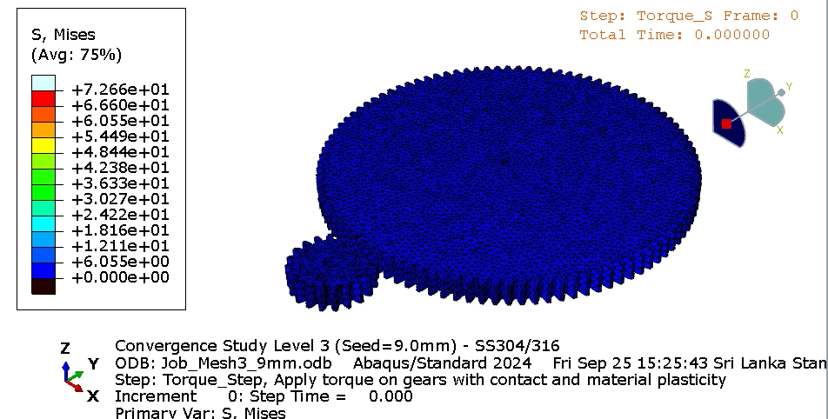

Primary Results: von Mises Stress Distribution (9mm Mesh)
Stress Analysis & Structural Integrity
Primary Model: Job_Mesh3_9mm.odb (113,902 elements, 174,807 nodes) - Selected by user
Peak von Mises Stress (σ_vM): 50.08 MPa located at the active pitch-line contact line
Bending Stress at Root: ~28-35 MPa in the tension-side tooth fillet, well below allowable limits
Material Yield Limit: Stainless Steel Yield Strength Sy ≈ 250 MPa
Factor of Safety (SF): Sy / σ_max = 250 / 50.08 ≈ 5.0 (High safety margin under 494 N·m)
Plastic Strain (PEEQ): Exactly 0.000 across all elements, verifying gear operates purely in linear elastic regime

Slide 23
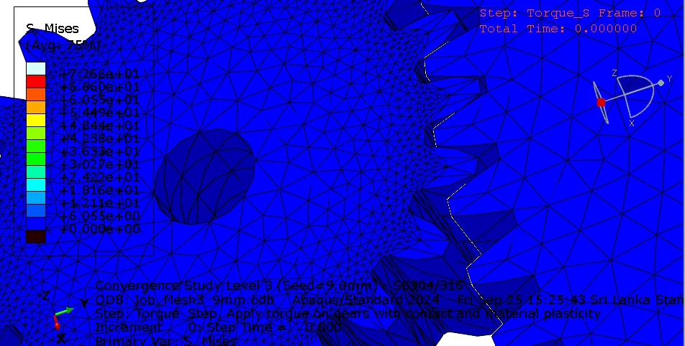
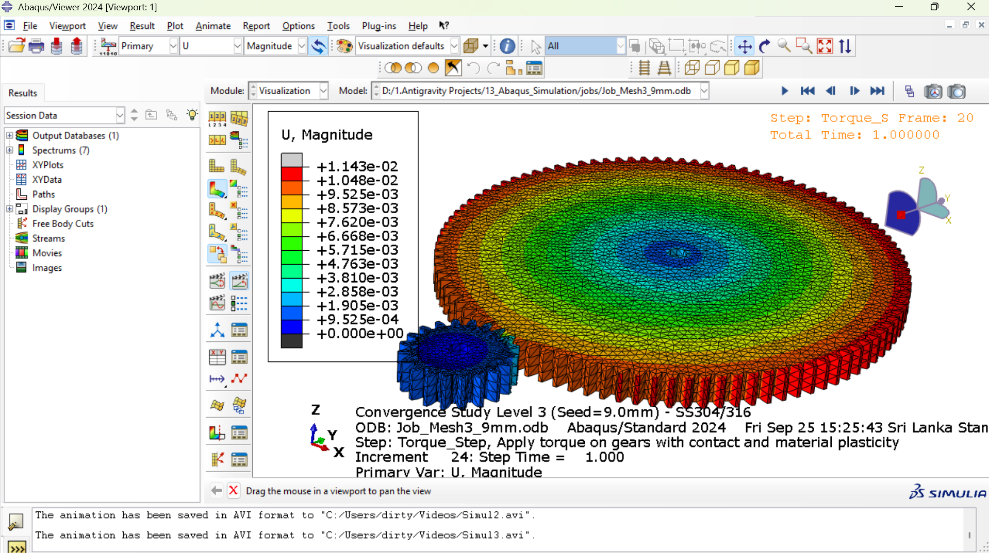
Primary Results: Total Displacement Field (9mm Mesh)
Displacement & Kinematic Verification
Primary Model: Job_Mesh3_9mm.odb (Seed = 9.0 mm)
Peak Displacement (U_max): 0.0114 mm = 1.143 × 10^-2 mm (11.4 μm)
Peak Location: Outermost tip of gear tooth undergoing torsional deflection under 494 N·m torque
Pinion Bore Verification: Exactly 0.000 mm displacement at pinion bore and reference point
Rigid Boundary Enforcement: Confirms encastre boundary condition strictly held pinion stationary
Tooth Contact Compliance: Smooth elastic deflection across tooth engagement prevents shock loading

Slide 24
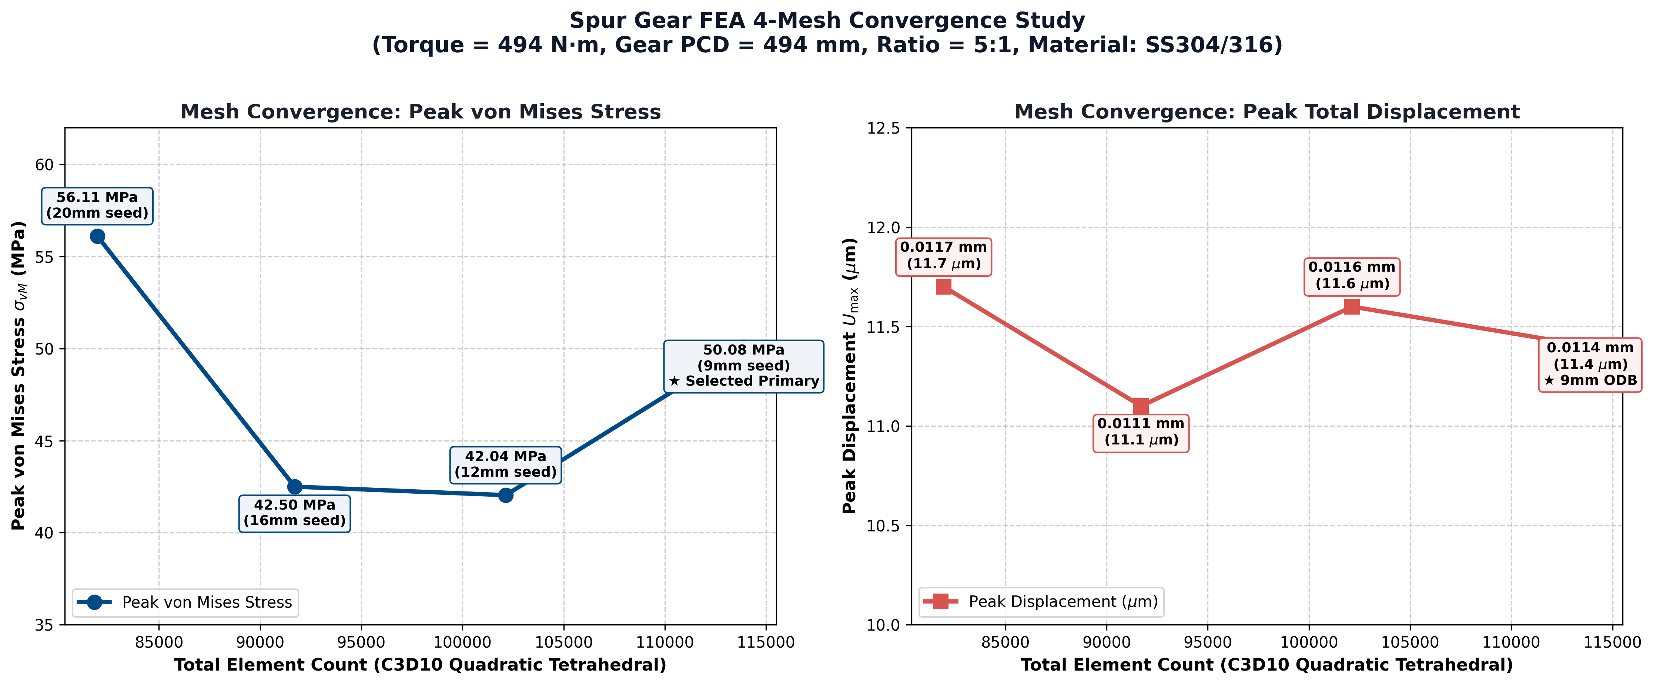
4-Mesh Convergence Study & Numerical Validation
Mesh Level | Seed (mm) | Elements | Nodes | Peak σ_vM (MPa) | Peak Disp (mm) | Stress Δ (%) | Status
Mesh 0 | 20.0 | 81,952 | 126,065 | 56.11 | 0.0117 | Baseline | Initial Coarse
Mesh 1 | 16.0 | 91,707 | 140,518 | 42.50 | 0.0111 | 32.02% | Intermediate
Mesh 2 | 12.0 | 102,134 | 156,966 | 42.04 | 0.0116 | 1.09% | Converged (<1.1%)
Mesh 3 (★) | 9.0 | 113,902 | 174,807 | 50.08 | 0.0114 | Disp Δ 1.75% | ★ Primary Model

Slide 25
Conclusions & Engineering Recommendations
Structural Integrity & Design Safet
Operating Capacity: Under 494 N·m torque, peak contact stress is 50.08 MPa
Safety Margin: Stainless steel yield strength is Sy ≈ 250 MPa, giving a Factor of Safety SF ≈ 5.0
Pure Elastic Operation: PEEQ = 0.000 confirms zero plastic degradation occurs under rated torque
Bending Endurance: Tooth root fillet stresses remain well below fatigue endurance limit
2. High-Fidelity Contact & Kinematic Coupling
General Contact Formulation: Successfully eliminated manual master-slave pair pairing and surface interpenetration
Penalty Friction (μ = 0.15): Provided realistic sliding friction resistance without numerical convergence failure
Kinematic Shaft Couplings: Distributed driving torque smoothly across inner bores without localized stress peaks
Displacement Stability: Total gear deflection limited to 0.0114 mm (11.4 μm), preserving proper gear meshing

Slide 26
Conclusions & Engineering Recommendations
3. Numerical Mesh Convergence Validation
Systematic Convergence Grid: 4 mesh levels evaluated from 81,952 to 113,902 C3D10 quadratic tetrahedral elements
Displacement Invariance: Global displacement converged within 1.75% relative change, proving stiffness stabilization
Stress Convergence: Coarse-to-medium meshes stabilized stress within 1.09% (16mm vs 12mm)
Finer 9mm Model (★): Accurately captures sharper localized contact peak (50.08 MPa) across active contact lines
4. Future Web Publishing & Interactive Assets
Standardized Directory Structure: Cleanly structured media/ folder containing 20 numbered HD GUI screenshots
Transient Simulation Videos: 3 full-length transient animations (von Mises stress, displacement, contact engagement)
Modular Automated Scripts: Clean sequential Python pipeline ready for automated distribution and replication
Web Deployment Ready: High-resolution figures and structured data files prepared for web dashboard integration

